Slide 1
Text Mining
Tim Smith, PhD

Slide 2
Agenda
What is text mining?
Structured vs. unstructured data
How to create the term-by-document matrix?
Singular value decomposition
Supervised vs. unsupervised text mining
Example project

Slide 3
Text mining is not…
Text mining is not:
Alexa
Google Assistant
Dictation (speech detection)
(Statistical) Text mining is finding patterns in text
It does not care about what words/phrases mean
It cares about “frequency” of words/ phrases

Slide 4
Why Text Mining?
Unstructured text is ubiquitous:
News stories, articles, blogs
Physician/nurse notes
Research articles
Can we take advantage of text (and find patterns in it)?

Slide 5
What is Text Mining?
Extracting patterns from text (i.e., unstructured data).
Two challenges:
What kind of patterns are we talking about?
Machine learning requires "structured" data! Text is "unstructured“!!!

Slide 6
Patterns
Tech news
Health news
________________________________________________________________
________________________________________________________________
________________________________________________________________
________________________________________________________________
________________________________________________________________
________________________________________________________________
processor, memory, storage, cloud, internet, …
blood pressure, cholesterol, cold, flu, …

Slide 7
Structured vs. Unstructured
Structured data set, and structured data:
Structured data set, but unstructured data
CustID | Age | Homeowner | Income
1 | 30 | 1 | 100,000
2 | 32 | 0 | 78,000
(etc.)
ID | News story
1 | Pediatricians should carefully evaluate kids with …
2 | Voters should register by …
(etc.)

Slide 8
Unstructured Data
From unstructured to structured
ID | News story
1 | Pediatricians should carefully evaluate kids with …
2 | Voters should register by …
(etc.)
How can we make this data STRUCTURED?

Slide 9
Term-by-document Matrix
Convert "unstructured" to "structured": (binary)
Term-by-document matrix
ID | News story
1 | Pediatricians should carefully evaluate kids with …
2 | Voters should register by …
(etc.)
ID | Pediatricians | Should | Carefully | (etc.)
1 | 1 | 1 | 1
2 | 0 | 1 | 0
(etc.)

Slide 10
Term-by-document Matrix
Different types of term-by-document matrix:
Binary (existence of a term: 1 or 0)
Count of a term
Term frequency = Count of a term / doc. term frequency (“normalizes” the count within a document)
Term frequency-inverse document frequency
Binary
Count
Term Frequency
ID | Pediatricians | Should | Carefully
1 | 1 | 1 | 1
2 | 0 | 1 | 0
(etc.)
ID | Pediatricians | Should | Carefully
1 | 9 | 6 | 1
2 | 0 | 13 | 0
(etc.)
ID | Pediatricians | Should | Carefully
1 | 0.09 | 0.06 | 0.01
2 | 0 | 0.257 | 0
(etc.)

Slide 11
TF-IDF
TF-IDF is another measure of a word’s importance in a document, among N documents
When to use it? Everywhere you use “word count,” you can likely use TF-IDF.
TF: term frequency = # appearances in a document
IDF: inverse document frequency = log( N / # of documents containing that term)
Note: this penalizes “common” words appearing in most documents)
Final score = TF * IDF
higher score means more “characteristic”

Slide 12
Term-by-document Matrix
How to create term-by-document matrix?
"Tokenization"
Breaking up a piece of text into words, numbers, symbols, etc.
Patient's blood pressure was 120 / 80

Slide 13
Tokenization
How to identify tokens?
Use delimiters:
Space
Tab
New line
Symbols: ( ) < > ? !
Punctuation: . , : ; - ' "
Not all punctuation create tokens:
$1,000.50
U.S.A.
isn't or D'angelo
(813)555-4578

Slide 14
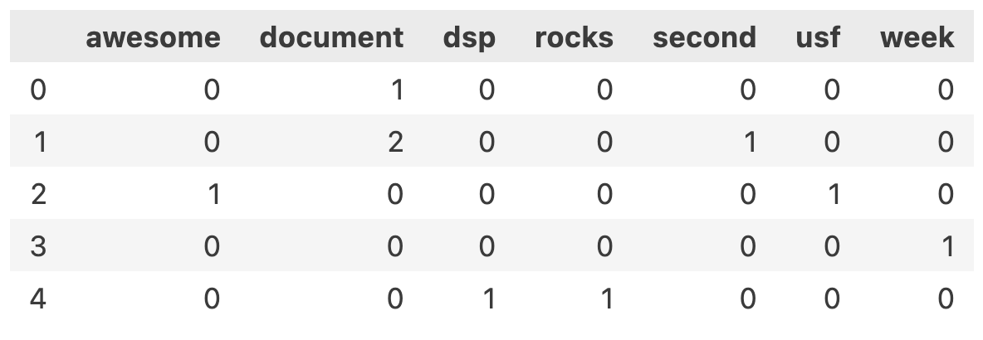
from sklearn.feature_extraction.text import CountVectorizer
import numpy as np
corpus = np.array([
'This is the!@# # first document.’,
'This Document 123 is the second document.’,
'USF is awesome!’,
'What week is this?’,
'DSP Rocks!'
])
# CountVectorizer will covert to lowercase, remove punctuation, and remove stop words - to
# remove other things, such as numbers, use the token_pattern parameter
vectorizer = CountVectorizer(stop_words='english', lowercase=True, token_pattern="[^\W\d_]+")
# [^\W\d_]+ not Word, not digit, not underscore -- see: https://regexr.com/
X = vectorizer.fit_transform(corpus)
df = pd.DataFrame(X.toarray(), columns=vectorizer.get_feature_names_out())
df

Slide 15
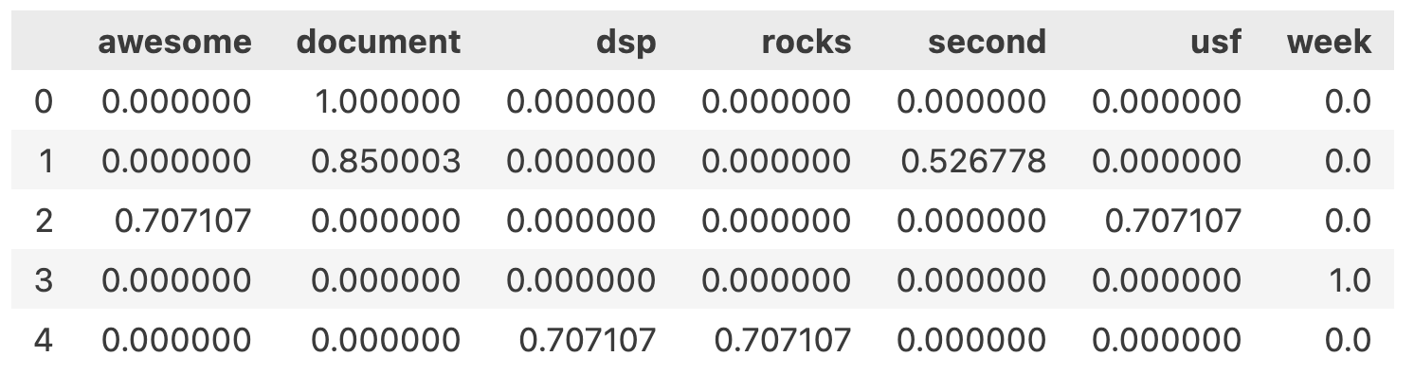
from sklearn.feature_extraction.text import TfidfVectorizer
# Like CountVectorizer, TfidfVectorizer will covert to lowercase, remove punctuation, and remove
# stop words - to remove other things, such as numbers, use the token_pattern parameter
vectorizer = TfidfVectorizer(stop_words='english', lowercase=True, token_pattern="[^\W\d_]+")
X = vectorizer.fit_transform(corpus)
df = pd.DataFrame(X.toarray(), columns=vectorizer.get_feature_names_out())
Df

Slide 16
Tokenization
Every token is in term-by-document matrix!!!
(Is this desirable/undesirable?)

Slide 17
Tokenization
How to reduce the number of tokens:
Conduct stemming
Conduct lemmatization
Eliminate stopwords
Correct misspelled tokens
Identify named-entities (part-of-speech tagging)

Slide 18
1. Stemming
A simple heuristic that removes the ends of words
Extract the root:
predictable, prediction → predict
different, differential, differing → differ

Slide 19
2. Lemmatization
Group those words together that have the same root or lemma
The words might have different inflections or derivatives of meaning
Example: Elimination of singular/plural, present/past:
boy, boy's, boys → boy
giving, gives, gave → give
be, are, was, were, been → to be

Slide 20
3. Stopwords
Stopwords: tokens that have little meaning
A, an, the, it, they, of, and, for, …
Little to NO predictive ability
Usually eliminated!

Slide 21
4. Use a Dictionary
Correct spelling errors:
seperate, separate → separate
fundemental, fundamental → fundamental
Create your own dictionary:
FLA, FL, Flor → Florida
Fall, fal, fell, feel, felt, feal, fel → fall
Use synonyms:
slip, take a spill, found on the floor → fall

Slide 22
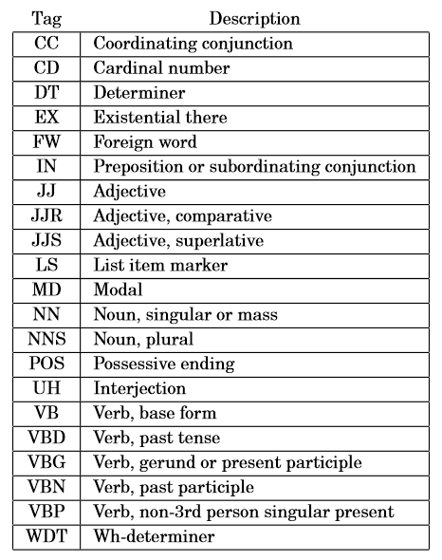
5. Part-of-Speech Tagging
Helps identify "phrases" (two or more tokens)

Slide 23
5. Part-of-Speech Tagging
Part-of speech tagging helps in two ways:
1) Eliminate certain phrases:
"as well as"
"even if"
"for all that"
2) Identify named-entities
"University of South Florida"
"United States of America"
Other named-entities that are helpful: names, organizations, countries, currencies, locations, date, time, percentage, etc.

Slide 24
Resulting Table
Transformed table:
A very LARGE table where
Each document is a single row
Each term is a single column
The values are tf-idf
Problem: there are thousands of columns!!!

Slide 25
Singular Value Decomposition (SVD)
Dimension reduction technique!
Same as Principal Components Analysis (PCA)
Also called “Latent Semantic Analysis” in text analysis
10,000 columns (dimensions) → 100 SVDs
Each SVD is a linear combination of the original columns

Slide 26
Singular Value Decomposition
We will only require an understanding of SVD as a tool:
SVD will reduce the number of dimensions of our data.
Term-by-document matrixes can be very large. SVD allows analysts to construct a much smaller representation of this data as linear combinations.
These linear combinations or “weighted sums ” can be used to more efficiently train predictive models.
To understand SVD deeply, see pages 935-947 of the following book (available online from the USF library)
Practical Text Mining and Statistical Analysis for Non-Structured Text Data Applications
Miner, Gary D ; Elder, John, IV ; Fast, Andrew ; Hill, Thomas ; Nisbet, Robert ; Delen, Dursun
Saint Louis: Elsevier Science & Technology; 2012

Slide 27
Summary
ID | News story
1 | Pediatricians should carefully evaluate kids with …
2 | Voters should register by …
(etc.)
ID | pediatrician | care | …
1 | 0.016 | 0 | …
2 | 0 | 0.057 | …
Etc.
ID | SVD1 | SVD2 | …
1 | 0.15 | -0.03 | …
2 | 0.24 | 0.76 | …
Etc.
From unstructured to structured
From structured to SVDs
NOW WHAT???

Slide 28
Now What???
Use ML Techniques!
Supervised learning
Regression
Classification
Unsupervised learning
Are there any clusters? (eg. Group news stories)
Which items go together? (eg. If you read this, you will also be interested in this)

Slide 29
Regression
Supervised: regression
ID | News story | # of times read
1 | Pediatricians should carefully evaluate kids with … | 156
2 | Voters should register by … | 220
(etc.)
ID | SVD1 | SVD2 | … | # of times read
1 | 0.15 | -0.03 | … | 156
2 | 0.24 | 0.76 | … | 220
Etc.

Slide 30
Classification
Supervised: classification
ID | News story | Health-related
1 | Pediatricians should carefully evaluate kids with … | 1
2 | Voters should register by … | 0
(etc.)
ID | SVD1 | SVD2 | … | Health-related
1 | 0.15 | -0.03 | … | 1
2 | 0.24 | 0.76 | … | 0
Etc.

Slide 31
Unsupervised
Unsupervised: clustering
ID | News story
1 | Pediatricians should carefully evaluate kids with …
2 | Voters should register by …
(etc.)
ID | SVD1 | SVD2 | …
1 | 0.15 | -0.03 | …
2 | 0.24 | 0.76 | …
Etc.

Slide 32
Be Careful…
Labeled data can be difficult to come by…
Some data is labeled by its nature. Examples:
News categories,
Spam email,
Authorship.
Some data is not labeled…

Slide 33
Data Labeling
Goal: Predict one's mood ("happy" or "not") from their tweet
TweetID | Tweet | Mood
1 | What a beautiful day!!!
2 | Got fired from work!
3 | Crying…
…

Slide 34
Data Labeling
Labeling the data can be TRICKY and COSTLY for classification tasks!
Common practices:
Two (or more) EXPERTS classify ALL documents/ statements independently; third EXPERT resolves conflicts
Two (or more) EXPERTS classify ALL documents/ statements together through discussion

Slide 35
Summary
What is text mining?
Structured vs. unstructured data
How to create the term-by-document matrix?
Singular value decomposition
Supervised vs. unsupervised text mining
Example project

